Slide 1
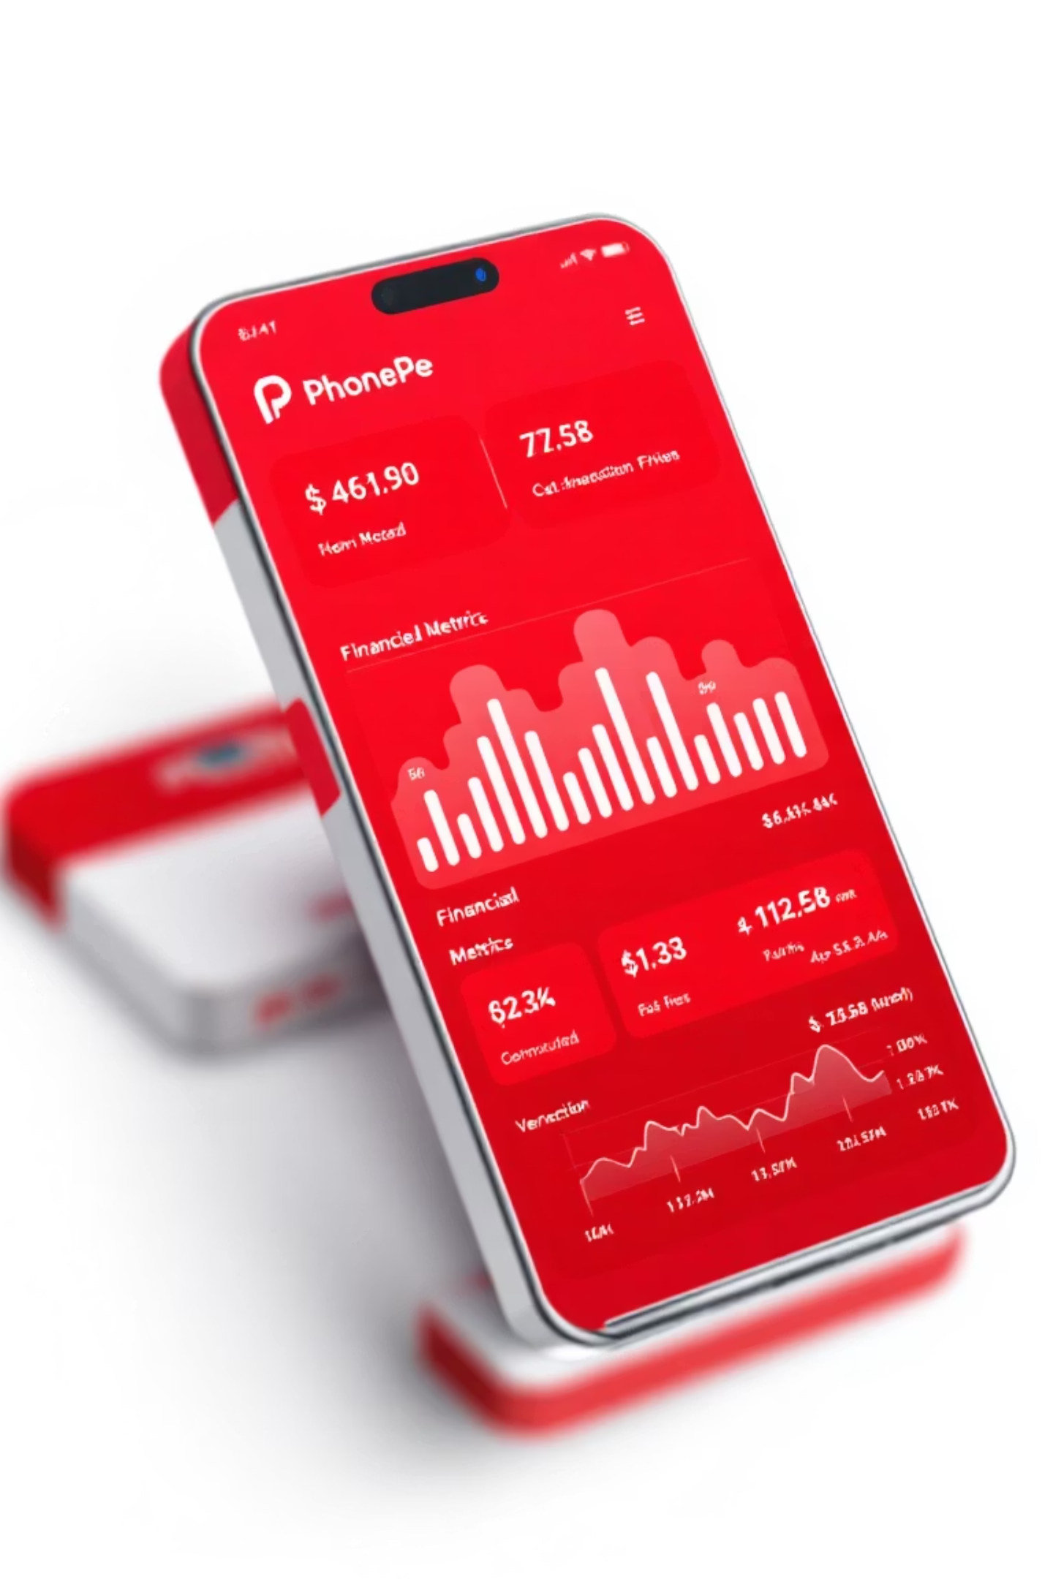
PhonePe 2024
Transaction Volumes, Success Rates & Optimization Roadmap
₹6.7B Processed
96% Success Rate
371K transactions in Q1
Strong baseline, room to optimize
Target: 99%
Focused fixes across services

Slide 2

Executive Summary: Q1 2024
₹6.7B
371K
356K
15K
Total Processed
Transactions
Successful
Failed
+15% YoY growth
+12% YoY growth
+18% YoY growth
-5% YoY decline
Top Service
Reliability Leaders
Loans/Credit: ₹2.4B (+20%)
Recharges/Bills: 99% success
Insurance: ₹513M (+10% MoM)
General Services: 96% success

Slide 3
Service Breakdown: Five Pillars
General Services
1
₹3.3B | 300K txns | 96% success
Issue: Server errors (67%)
Insurance
2
₹513M | Car/Bike/Life/Health
Issue: 48% success, Wrong PIN (77%)
Loans & Credit
3
₹2.4B | Auto/Gold/Mutual Funds
Critical: 2.84% success, 97% fail
Money Transfer
4
₹378M | 20.4K txns | 70% success
Issue: Insufficient funds (45%)
Recharges & Bills
5
₹51M | 51K txns | 99% success
Electricity, DTH, Mobile, Cable

Slide 4
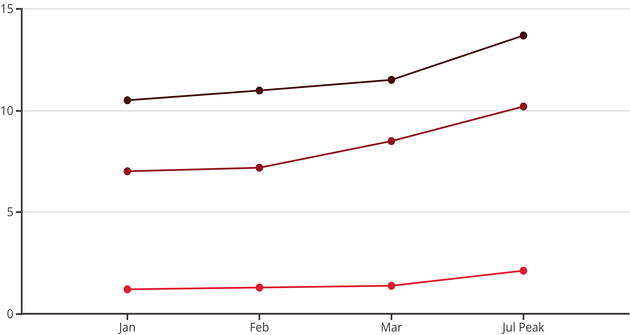
Trends & Growth Trajectory
General (₹M)
Loans (₹M)
Insurance (₹M)
1
Q1 Momentum
2
Seasonal Peaks
10-15% MoM growth signals habit-forming behavior
Mid-year surge (Jul-Oct) for insurance & loans
3
Q4 Projection
4
Priority Fix
25% holiday spike expected; ₹28B full-year target
Credit loans: 36% volume, 97% failure rate—urgent overhaul needed

